Slide 1

AI Enabled
Baby Health Care System
Presented By: Deepankar Sharma

Slide 2
contents
01
Problem Identification
02
Prior Existing Solution
03
Physical Structure of our Solution
04
Operation/Function/Use
05
Feedback

Slide 3
Problem Identification
01
Both Parents are busy/working
Single Parent
Small babies can’t say what they want
Not every parents know the best (specially first time)
Insufficient Childcare

Slide 4
Prior Existing Solutions
02
Baby sitters
Childcare Institutions
Let some relative or guardian take care
Baby Care toys (not smart enough)

Slide 5
02
Problems with the Prior Existing Solutions
Separation Anxiety
Stressful
Social Isolation
.
Bonding issues

Slide 6
Physical Structure of Our Solution
03
Community App (Advices from Others)
Reinforcement Learning Assistant (Learn as Child Grows)
CNN and NLP for Emotion Recognition

Slide 7
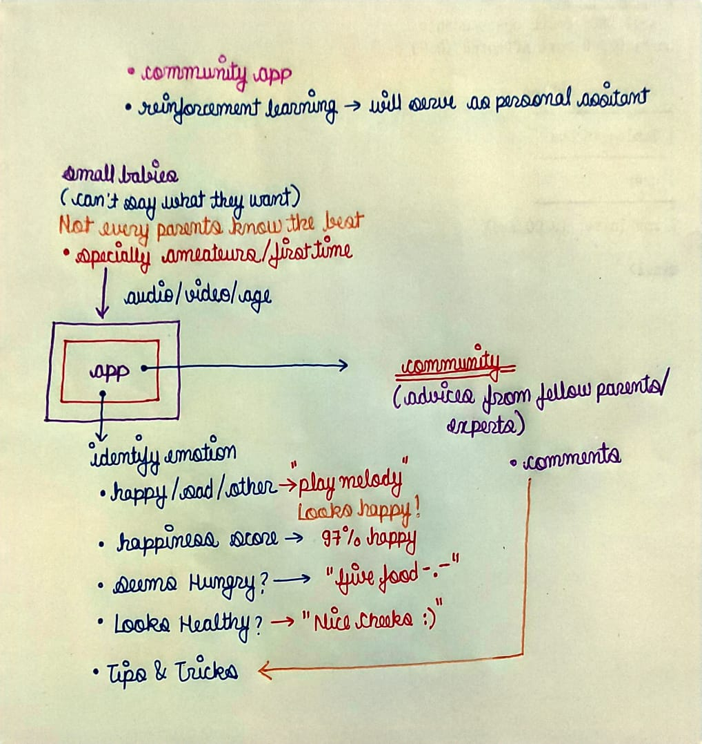
03
Physical Structure of Our Solution

Slide 8
Operations/Functions/Use
04
Facial Mood Detection Classifier
Voice Mood Detection Classifier
Customized AI Assistant using RL
Recommendation System for arbitary actions (identify genre)

Slide 9
04
Operations/Functions/Use
Customizable
Cloud
Being built upon RL the system will learn according the child specifically so it will always be flexible and customized to the indivisual child.
Instead of building everything from scratch , we can leverage already available cloud APIs.
Community
Deployable
The community environment will make this app dedicated for the purpose of parenting where people can interact with other parents..
Later Objective but it’s about deploying the app into customized robots.

Slide 10

Feedback
05

Slide 11
THANK YOU!

